Slide 1
Shanghai Open University (SOU) International Staff Exchange Fellowship Program
Duration: 15 May – 26 May 2017

Slide 3
Program Objectives
To share experience
To conduct independent study
To collaborate

Slide 4
Overview: Shanghai Open University (SOU)
Shanghai Open University formerly known as Shanghai Television University
SOU adopted blended approach to deliver its T&L activities
On July 25, 2012, the university officially changed its name to Shanghai Open University
It offers Associate and bachelor's degrees
Motto: “For all learners & all for the learners,”

Slide 5
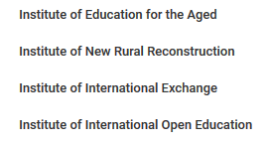
Overview: Shanghai Open University (SOU)
In the past 50 years, Shanghai Open University has trained 350,000 graduates
Currently, the number of students pursuing degree education in SOU is 110,000, and the number for non-degree education is up to 500,000
Institutes:

Slide 6
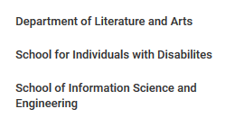
Overview: Shanghai Open University (SOU)
Schools:
*41 branch schools covering 17 districts and regions of the city

Slide 7
Overview: Shanghai Open University (SOU)
There are 1480 full time instructors and 2730 part time teachers in SOU

Slide 8
Program Main Activities
Visit to learning centers centers
Self-research
Interaction/meeting with the faculties, teaching center and R&D unit
Campus tour
Conduct seminar (ICT in ODL, Student Supports in ODL, QA in ODL, Education for Disabled Person)

Slide 9
My focus…
E-Learning
Online Assessment
My final report:
Implementing online assessment in the ODL
mode

Slide 10
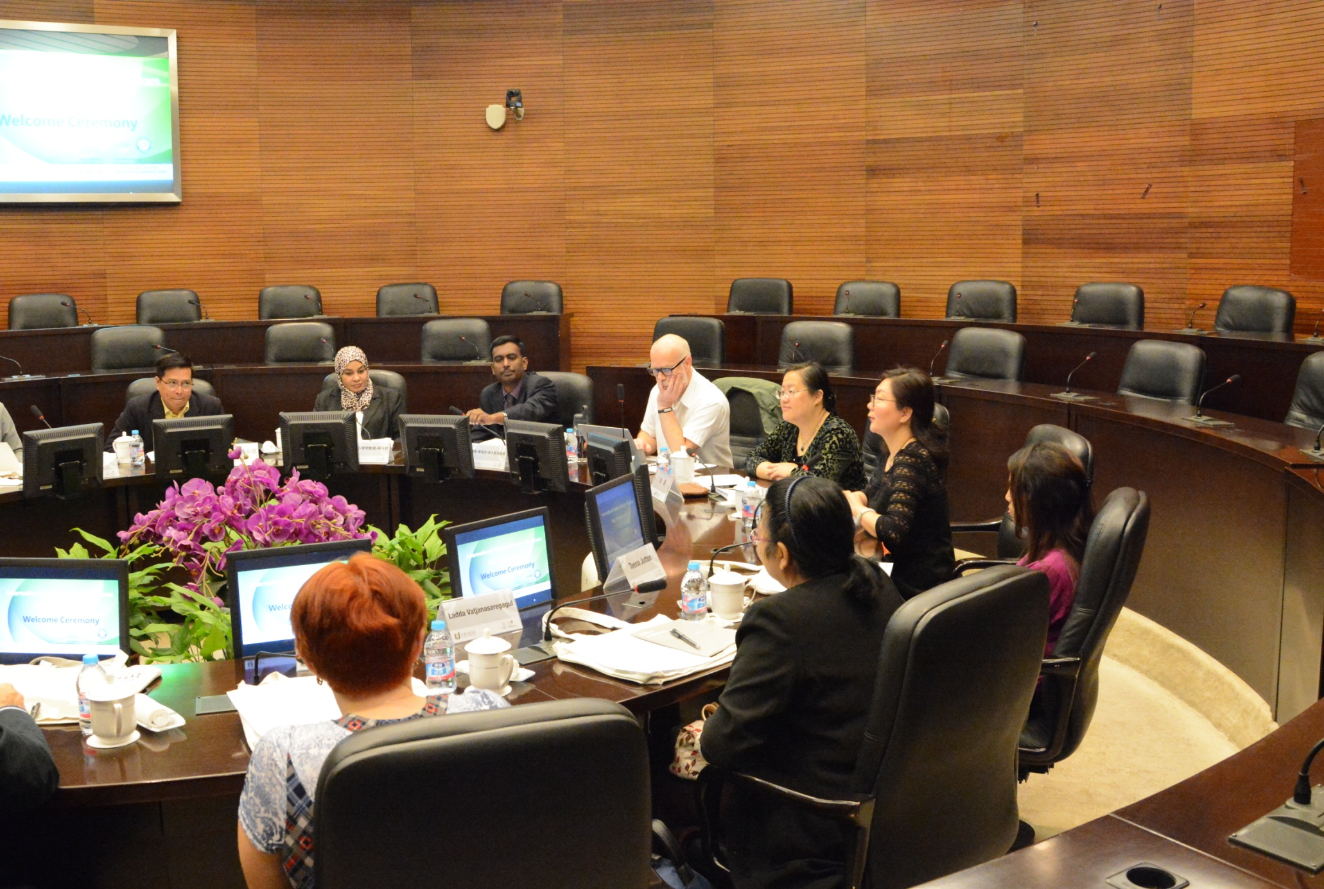

Slide 12
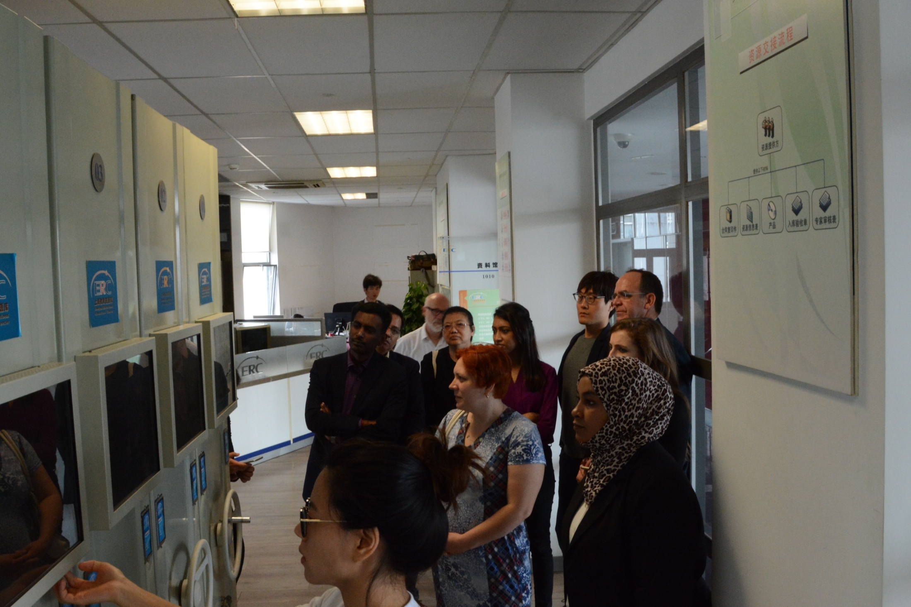

Slide 13
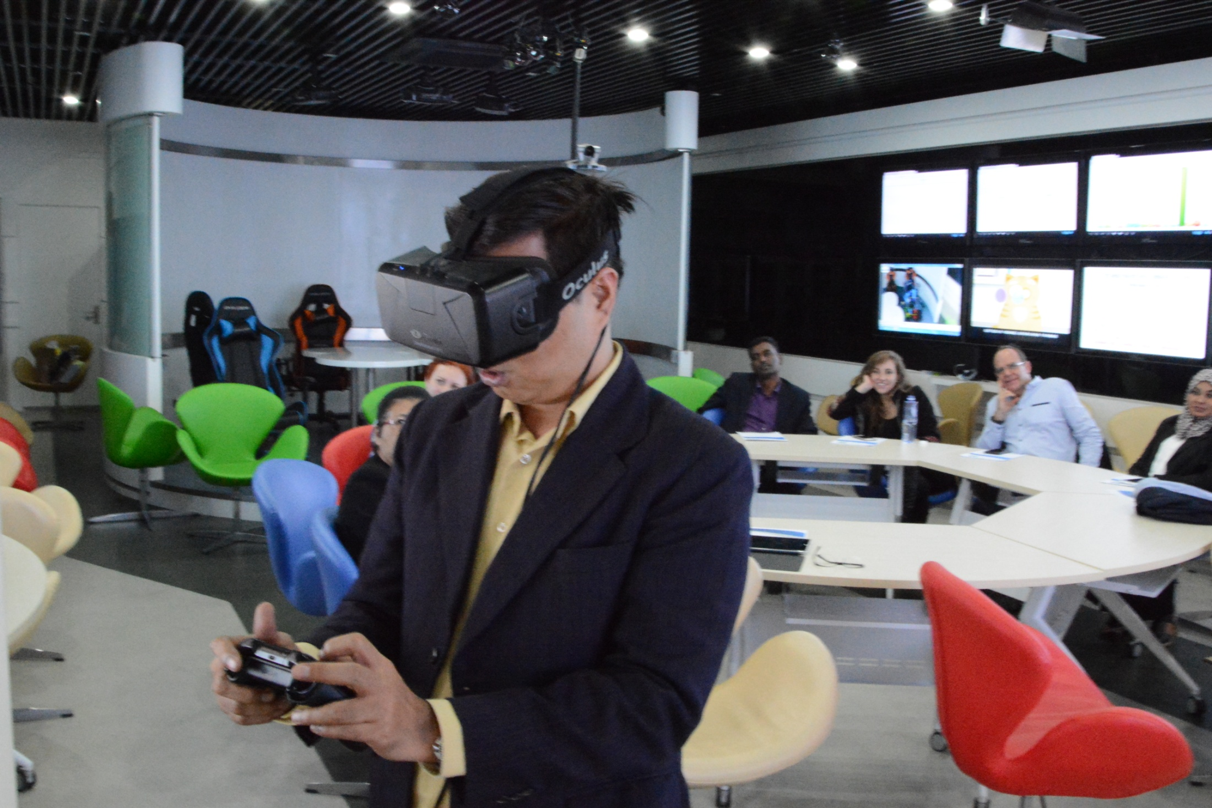

Slide 14
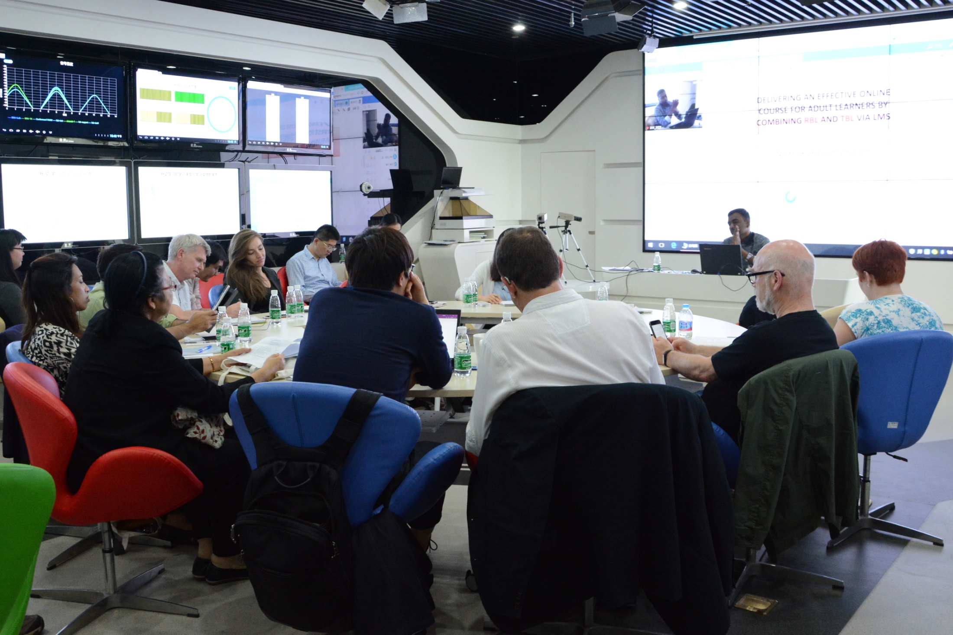

Slide 15
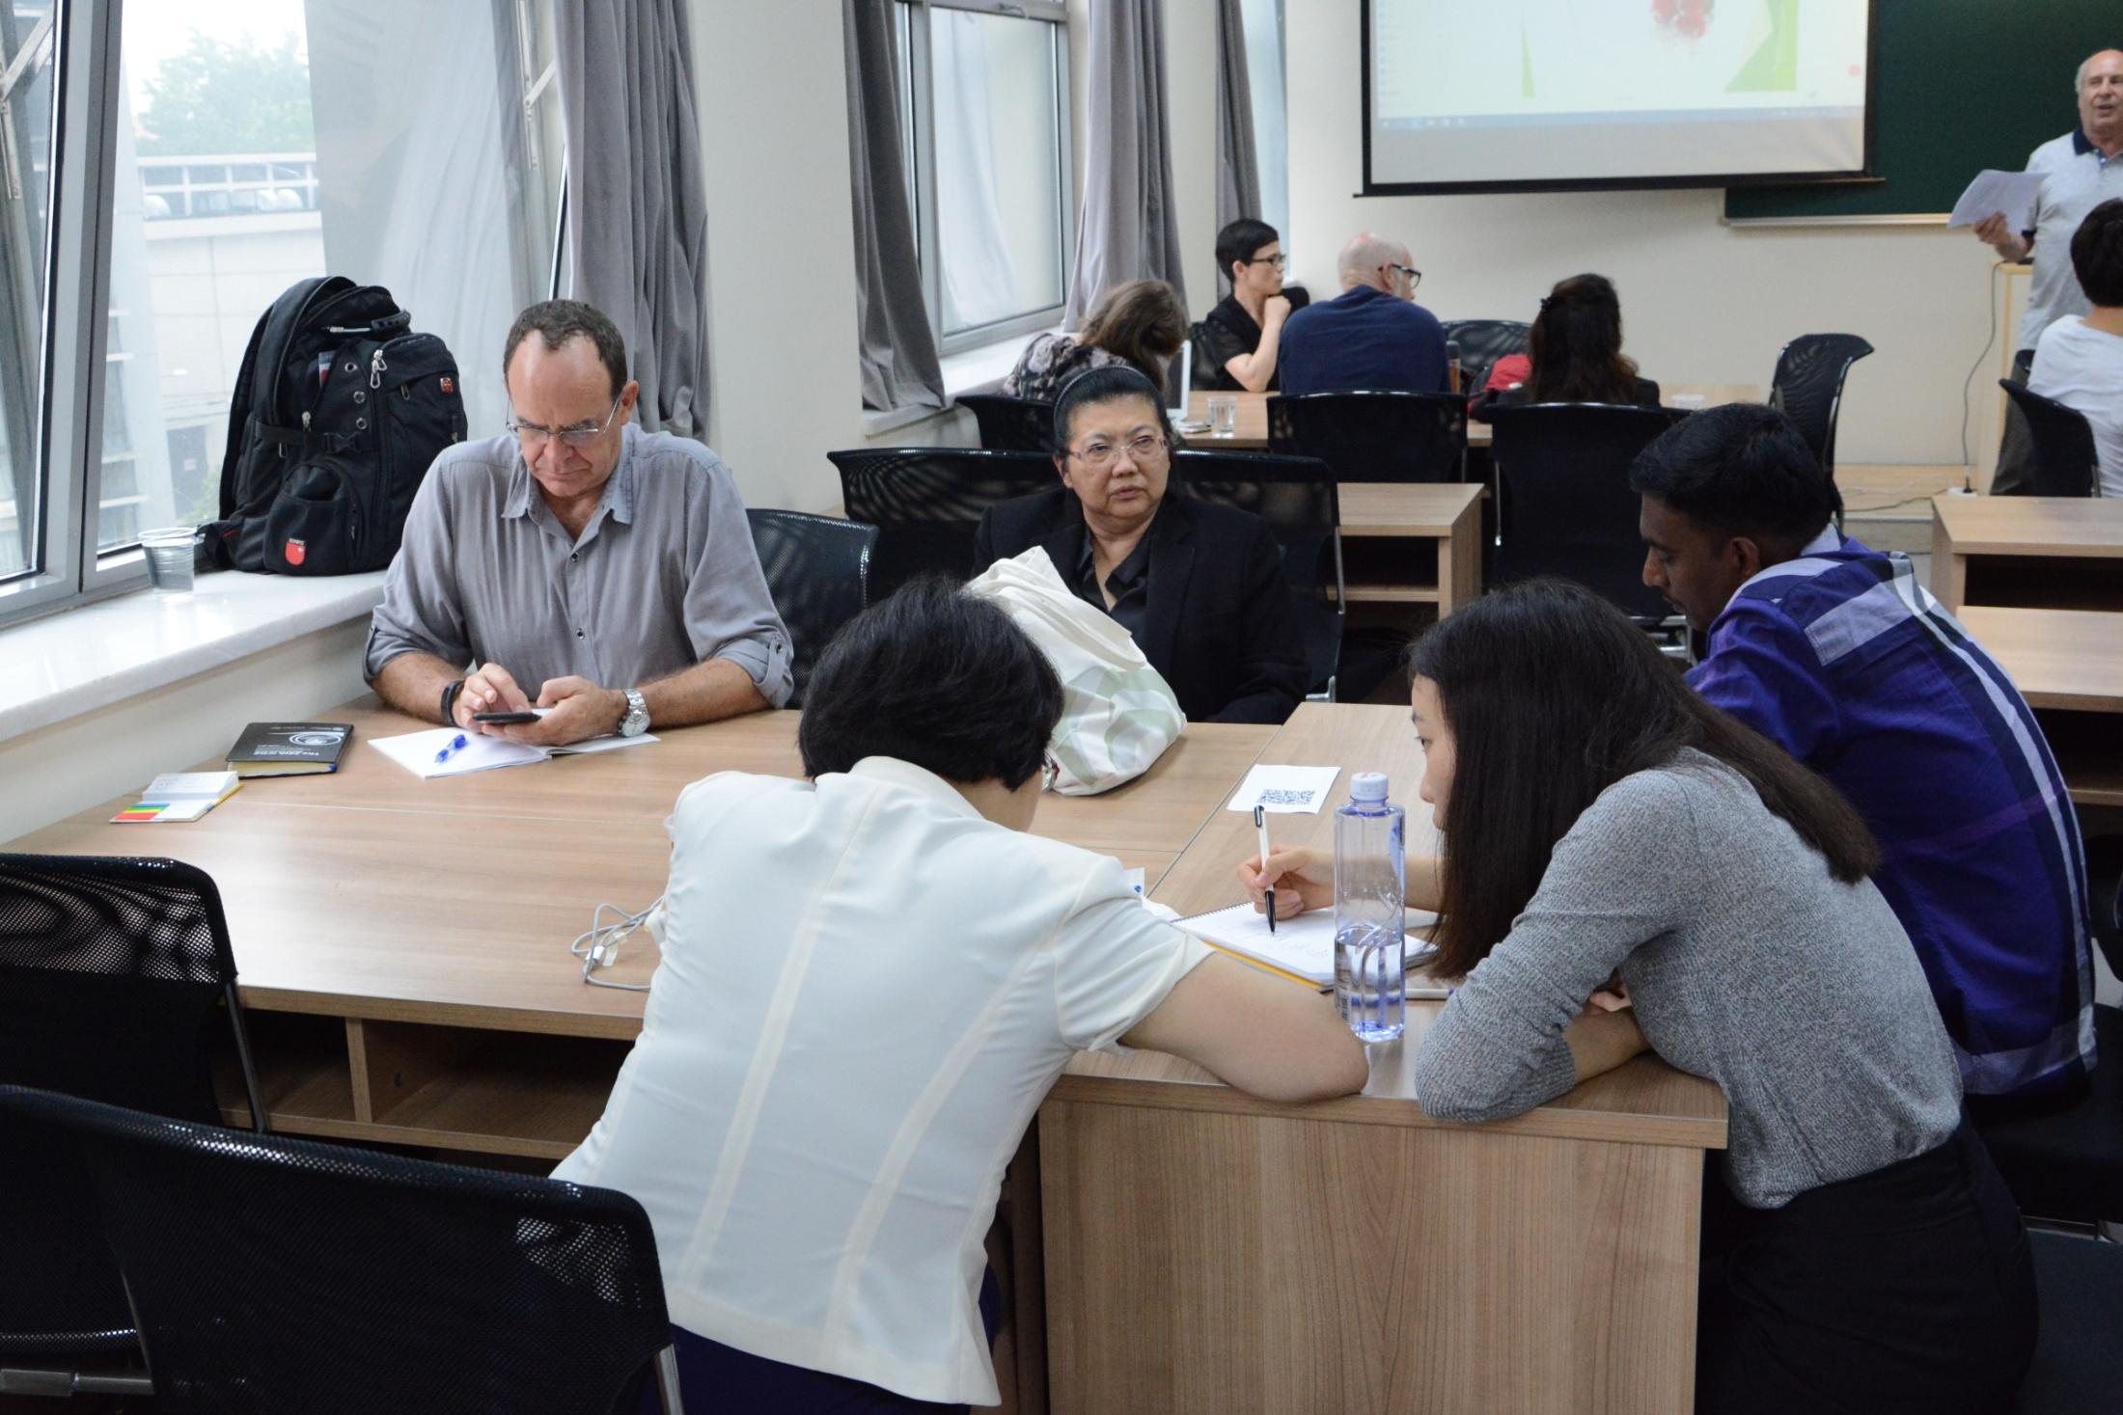

Slide 16
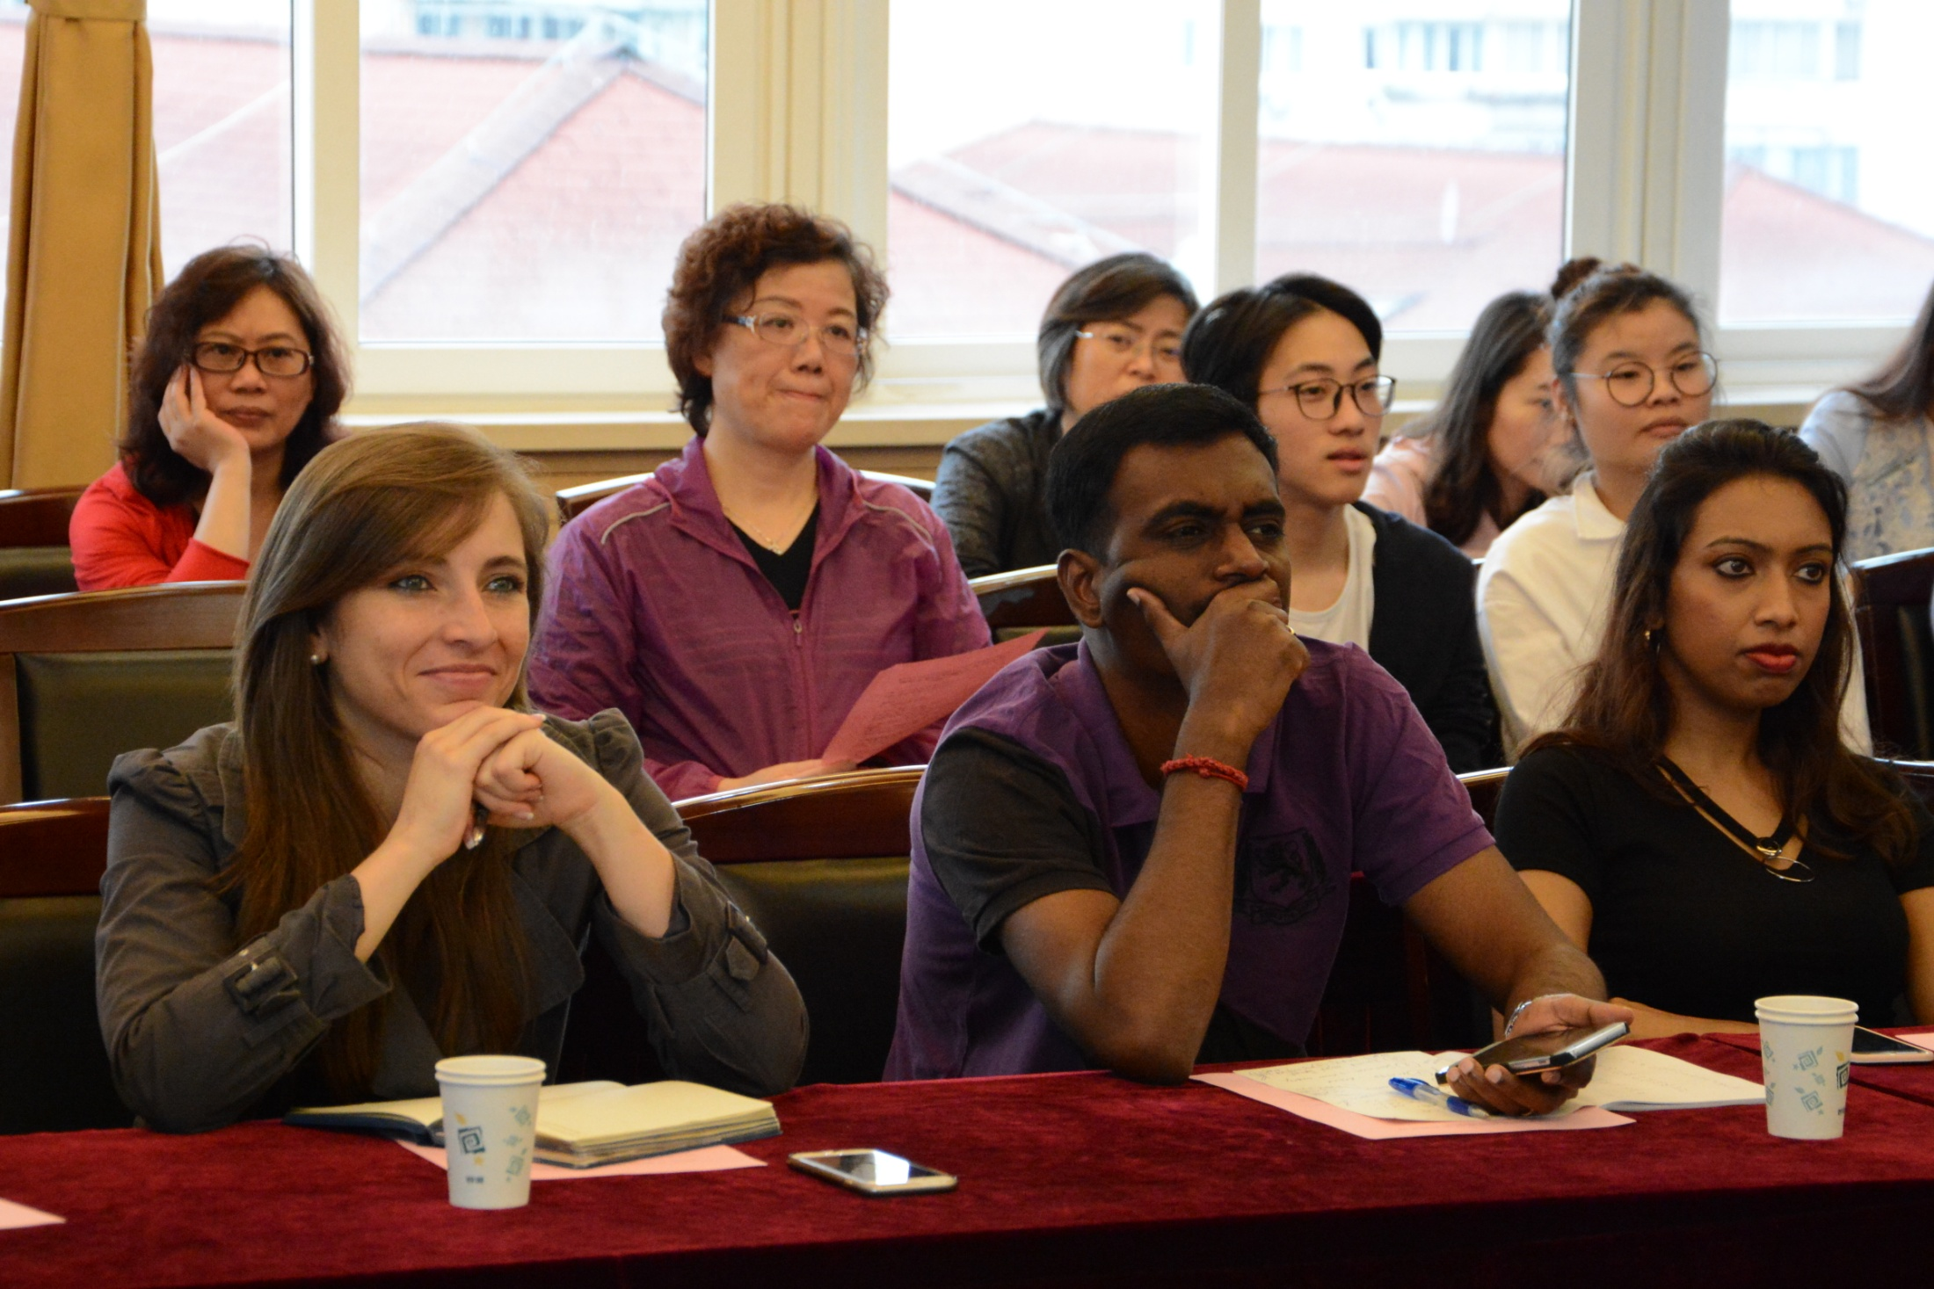

Slide 18
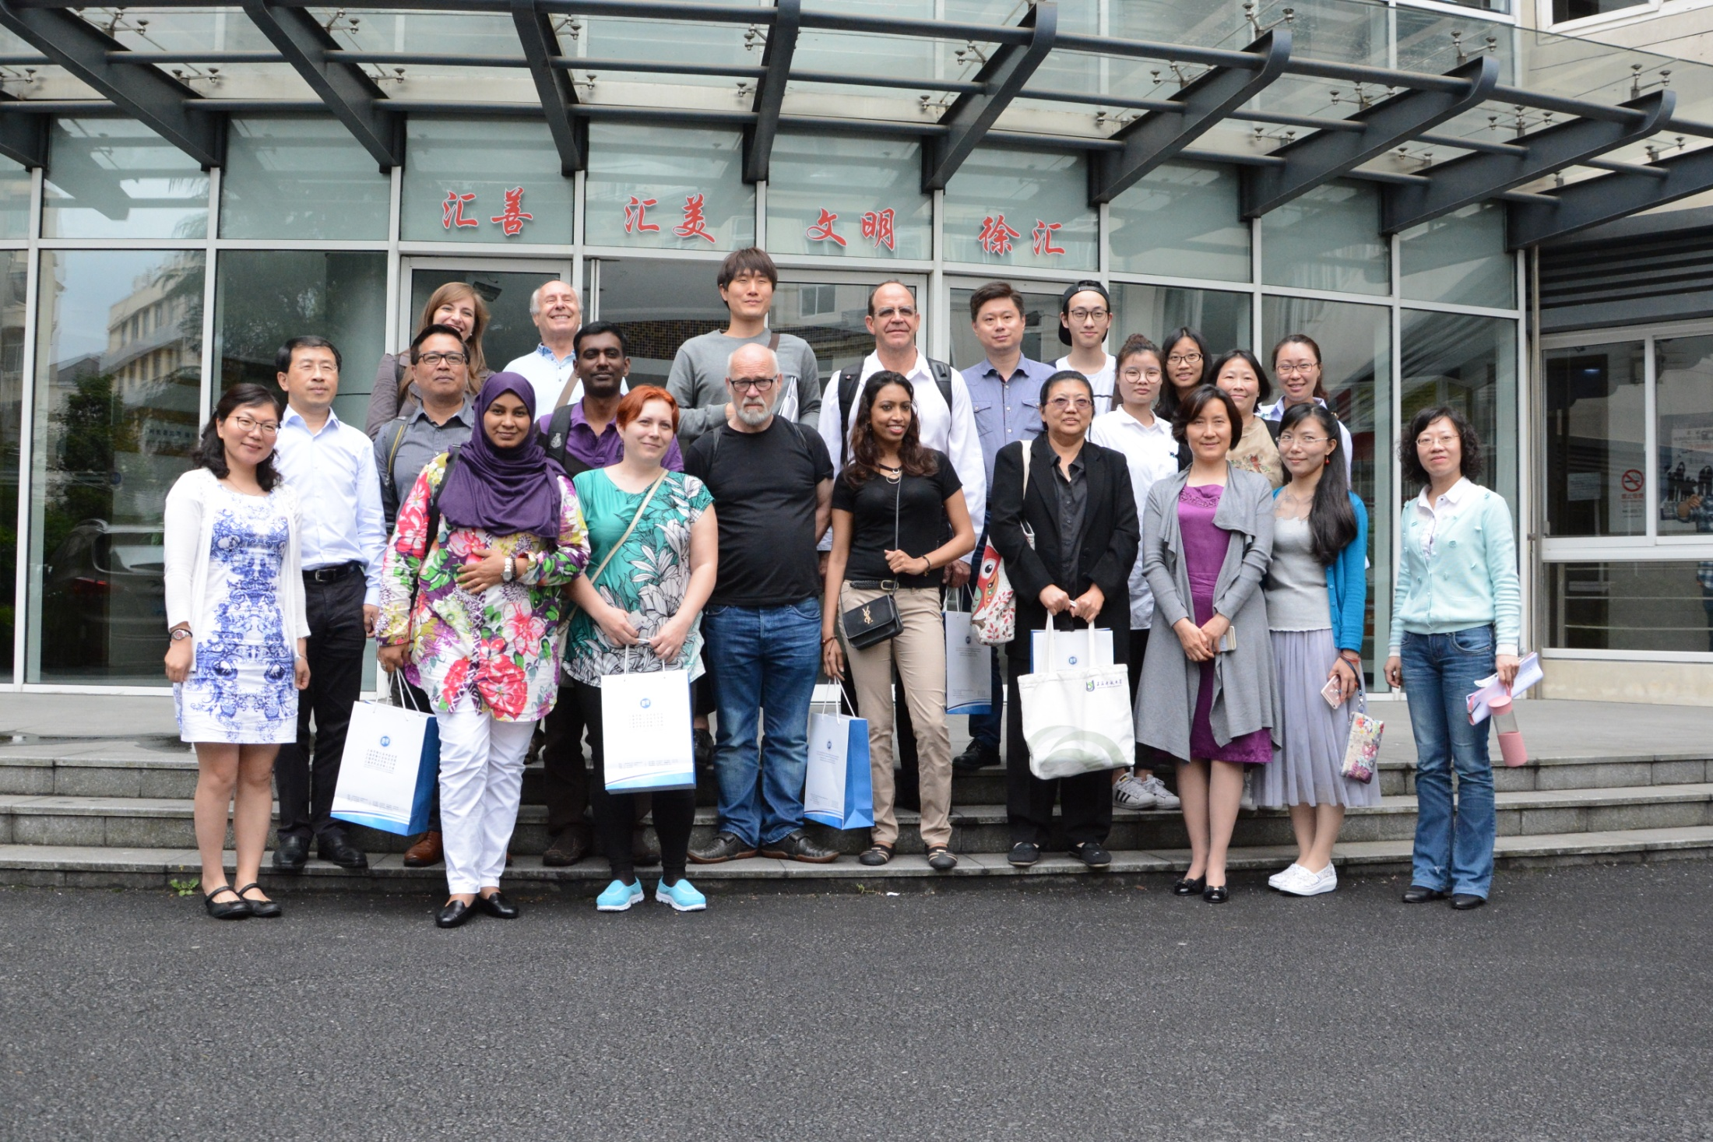

Slide 19
Thank you..

